Slide 1
Science 8-Chapter 2
Lesson 4 HD Notes Answers

Slide 2
The force of a bat on a ball and the force of a ball on a bat are a(n) ____________________.

Slide 3
The force of a bat on a ball and the force of a ball on a bat are a(n) force pair.

Slide 4
A ball with momentum 16 kg ● m/s strikes a ball at rest. What is the total momentum of both balls after the collision?
- 16 kg ● m/s
- 8 kg ● m/s
8 kg ● m/s
16 kg ● m/s

Slide 5
A ball with momentum 16 kg ● m/s strikes a ball at rest. What is the total momentum of both balls after the collision?
- 16 kg ● m/s
- 8 kg ● m/s
8 kg ● m/s
16 kg ● m/s

Slide 6
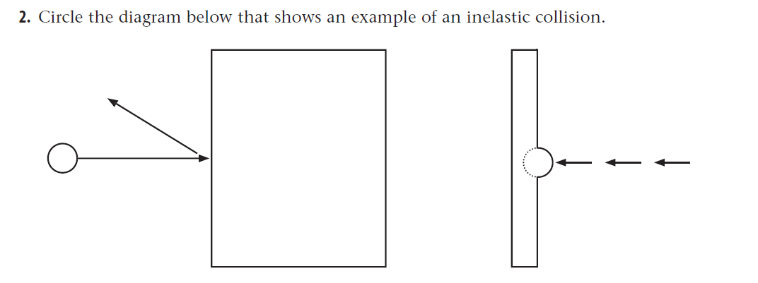
#3

Slide 7
#3

Slide 8
#4
If a tennis ball and a bowling ball are rolling at the same speed, which ball is harder to stop. Explain why.
The bowling ball
The bowling ball has more mass.

